Slide 1
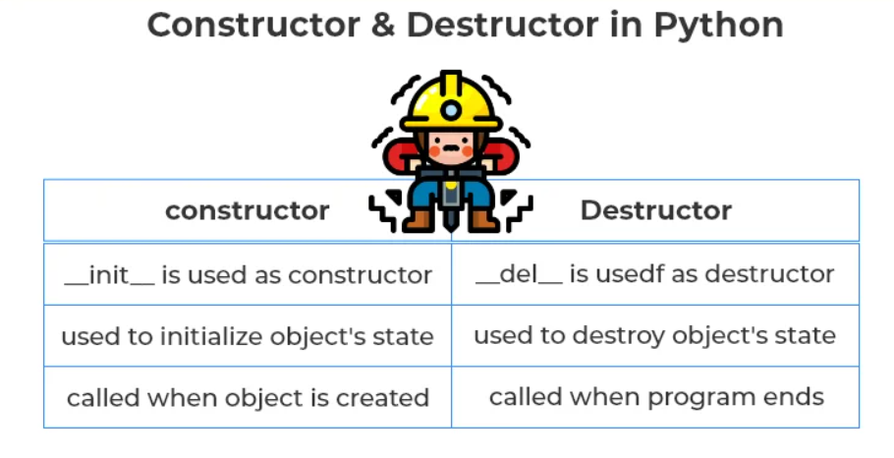
Constructor & Destructor
Constructor: A constructor in Python is a special type of method which is used to initialize the instance members of the class.
Destructor: Destructor in Python is called when an object gets destroyed.

